Slide 1
Introduction to Federal Income Tax Law

Slide 2
Tax Law Basics
All income is taxable,
  unless the law says it is not
No deduction is allowed,
  unless the law says it is
No credit is allowed,
  unless the law says it is

Slide 3
Tax Law Basics
  Income:
  Minus adjustments
= Adjusted gross Income
  Minus deductions and exemptions
= Taxable Income

Slide 4
Form 1040
Identity, filing status and exemptions
Income
Adjustments
Deductions and exemptions
Tax and nonrefundable credits
Additional taxes
Refundable credits and payments

Slide 5
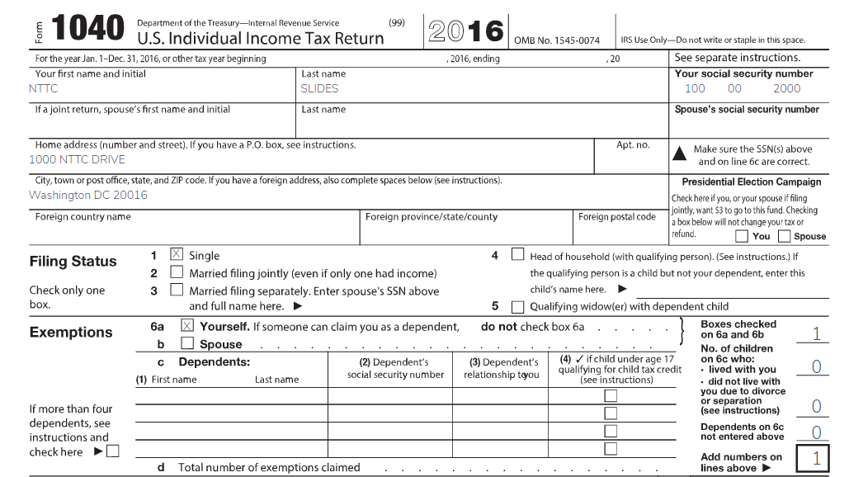
Form 1040 - TaxSlayer
Notes:
Select one status as shown on this form 1040.

Slide 6
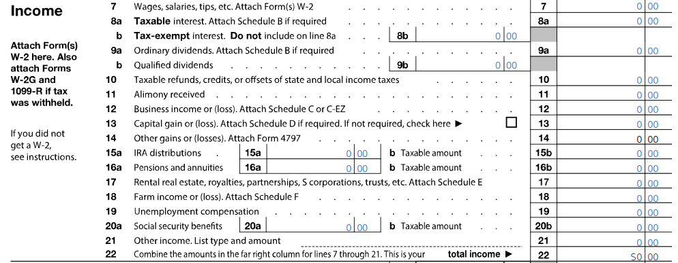
Form 1040 - Income

Slide 7
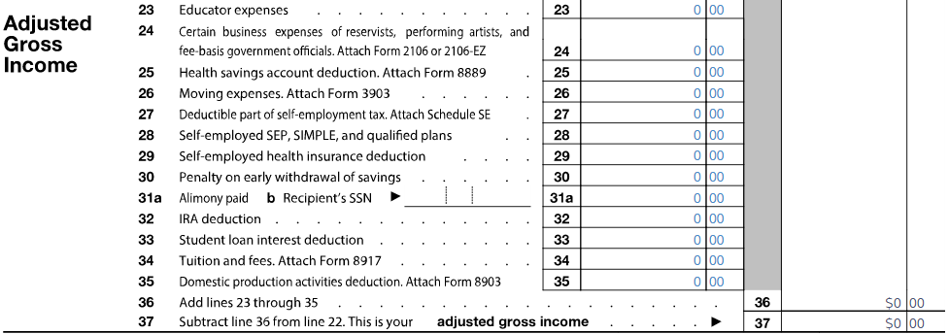
Form 1040 - Adjustments

Slide 8
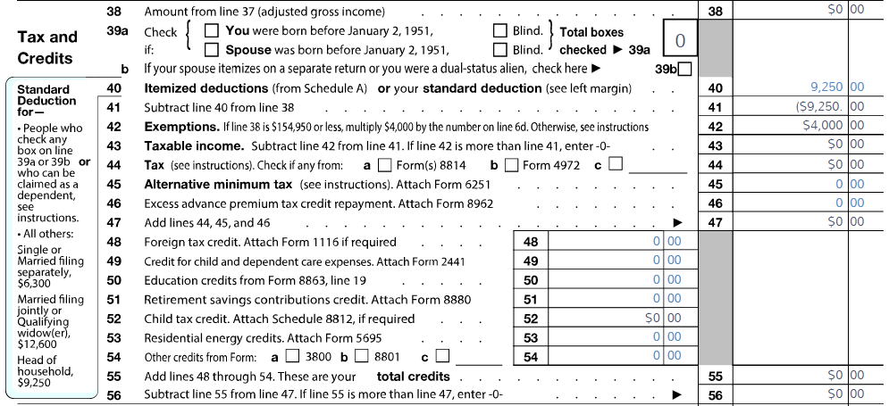
Form 1040 – page 2
Nonrefundable

Slide 9
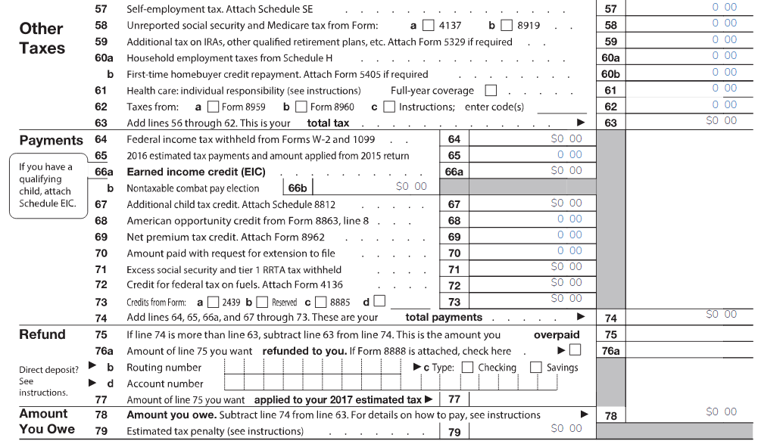
Form 1040 - page 2 cont.
Refundable
Notes:
Lines 61 and 69 were new with ACA. If the taxpayer and all dependent have Minimum Essential Coverage (MEC), the box on line 61 is checked. If the taxpayer or dependents do not have MEC and are not eligible for an exemption, a Shared Responsibility Payment (SRP) is entered on line 61. A refundable net premium tax credit as determined from Form 8962 is entered on line 69.

Slide 10
Training Materials
Pub 4491 – Text book
NTTC Workbook – Practice Exercises
Pub 4012 – Resource Guide
Form 6674 – Certification Test and Retest
TaxSlayer Practice Lab – Sections 4 & 6 of HOME page
linklearncertification.com
Pub 17 – Your Federal Income Tax for Individuals

Slide 11
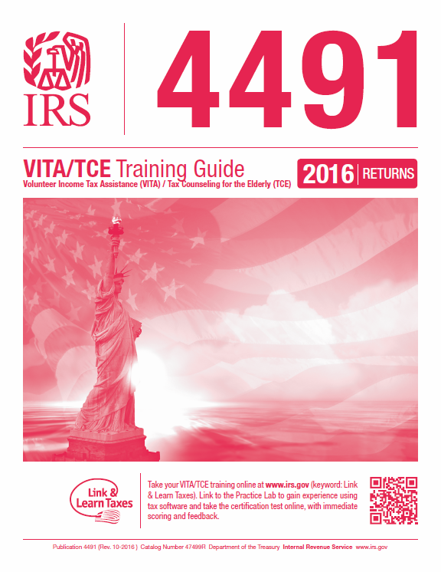
The Text Book
Electronic Only!!
Notes:
This Pub has been updated for 2016 and will be available Electronically Only!

Slide 12
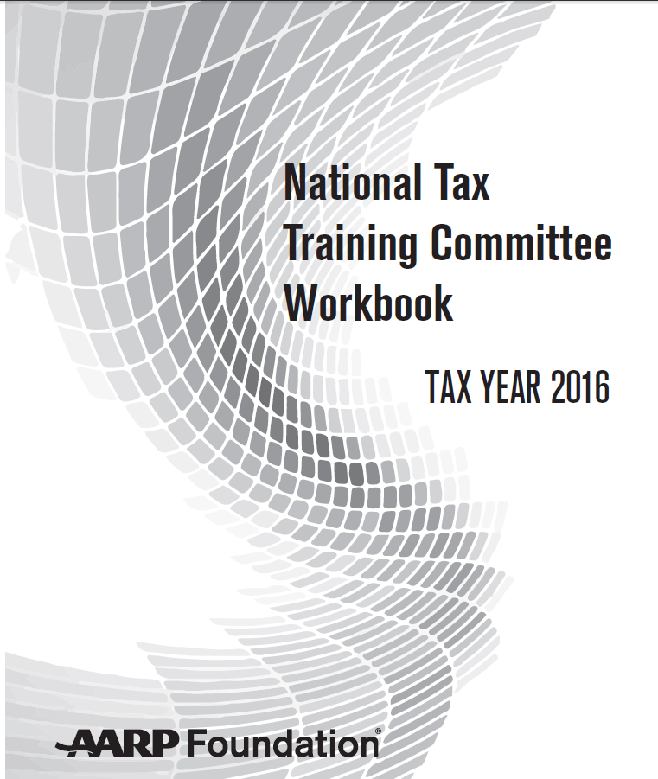
New Workbook
Notes:
See next slide for features of NTTC workbook.

Slide 13
NTTC Workbook – Practice Exercises
Contains 16 exercises;
Includes ACA questions;
Filing Status and Exemption Exercises; and Quizzes
Available on OneSupport Help Center and by ordering through Portal

Slide 14

The Golden Book
Primary Reference
Tool
Contains new ‘What’s New’ Tab
NTTC version on OneSupport
Notes:
The 2016 version of the 4012 will be unbound, 3 – hole punched with a 1” ring (no binder) and shrink-wrapped. It will be necessary to insert the tabs.

Slide 15
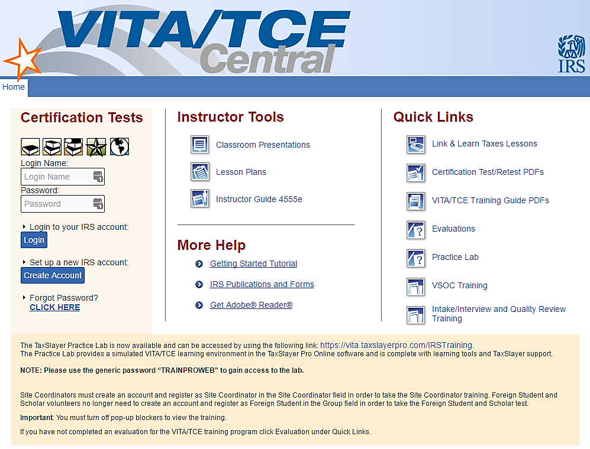
https://www.linklearncertification.com/
Notes:
IRS Link and Learn front page. Create an account and REMEMBER your login and password.
Certification Tests
Instructor Tools
Quick Links including online lesson and Practice Lab
More Help

Slide 16
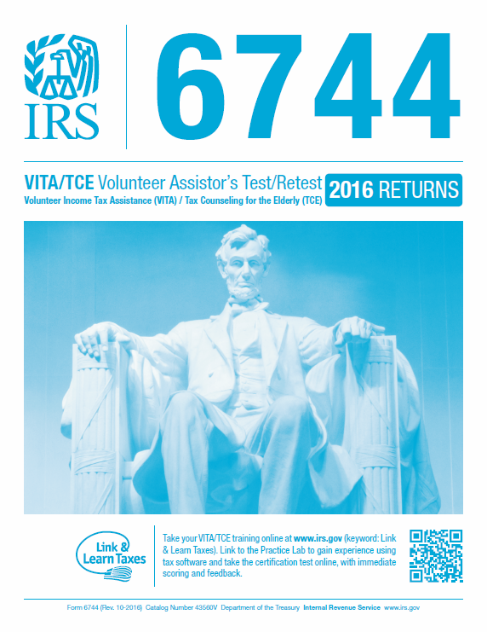
The Test

Slide 17
Introduction to Income Tax
Questions…
Comments…

